Slide 1


Oracle database
Lecture 22

Slide 2

Today’s Agenda
MultiColumn SubQueries
Using The ANY, ALL & SOME Operators
Using The EXISTS and NOT EXISTS Operators
NOT EXISTS V/s NOT IN

Slide 3
MultiColumn SubQueries
So far, the subquery examples we have discussed have returned a single column and one or more rows.
In certain situations, however, we can use subqueries that return two or more columns.
Such subqueries are called MULTICOLUMN SUBQUERIES

Slide 4
An Example
To understand the concept MULTICOLUMN SUBQUERY , consider the following table.
Now based on the above table try solving the query given next.
A_Name | A_Age | A_Country
Sunil | 26 | India
Mark | 35 | USA
Rajiv | 22 | India
Walter | 31 | Australia
Anwar | 30 | Pak
Suleman | 32 | Pak

Slide 5
An Example
WAQ to display name and age of eldest athelete of every country.
One way to solve the query is to use CORRELATED SUBQUERY:
SELECT A_name,A_age
FROM Atheletes A1
Where age = (Select max(age) from Atheletes A2 where A2.A_country=A1.A_country);

Slide 6
An Example
The same query can be written in a much simpler way if we can compare both age and country in the outer queries WHERE clause.
This is where MULTICOLUMN SUBQUERY comes into picture.
A MULTICOLUMN SUBQUERY allows us to compare multiple columns in the WHERE clause to multiple columns of a subquery.

Slide 7
An Example
So a much simpler version of the above query will be:
SELECT A_name,A_age
FROM Atheletes
Where (age,country) in (Select max(age),country from Atheletes group by A_country);
The execution steps are just like those for the previous simple subqueries.
First, the innermost query determines the max age of atheletes for each country.
Then the pairs of columns are compared.
If the column pair matches, Oracle displays the record.

Slide 8
Points To Remember
No of columns in the WHERE clause of OUTER QUERY and the SELECT clause of INNER QUERY must be same.
It is compulsory to enclose all the columns mentioned in the WHERE clause of the OUTER QUERY in a pair of parenthesis.
Order of columns in WHERE clause of OUTER QUERY and the SELECT clause of INNER QUERY must be same.

Slide 9
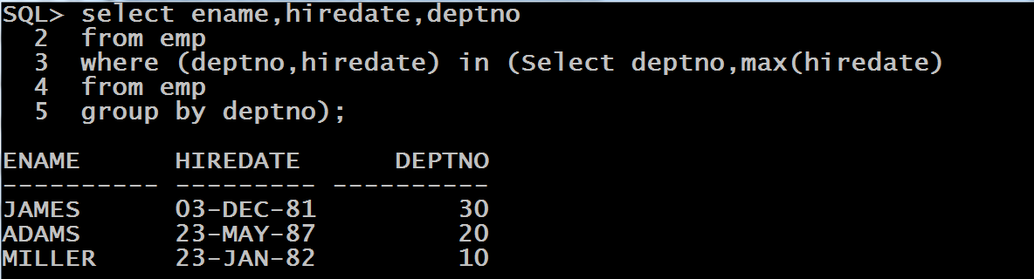
Queries
WAQ, to display the names of last hired employee along with his hiredate for each department.

Slide 10
The SOME, ANY And ALL Operators
These operators are used with relational operators and they compare the outer value to each of the value in the list generated by INNER QUERY .
They have the power to make all relational operators behave like multi valued comparison operator.
The ANY operator checks whether any value in the list makes the condition true.
The ALL operator returns rows if the condition is true for all the values in the list.
The SOME operator is identical to ANY, and the two can be used interchangeably.

Slide 11
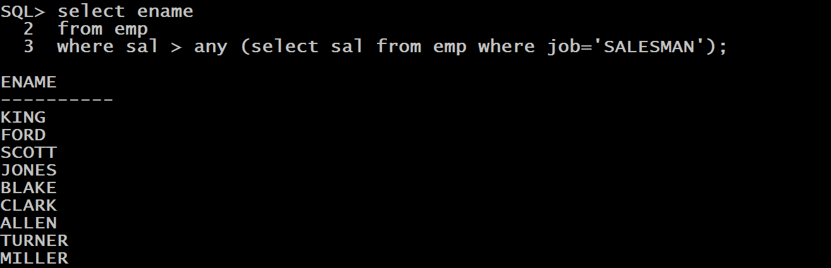
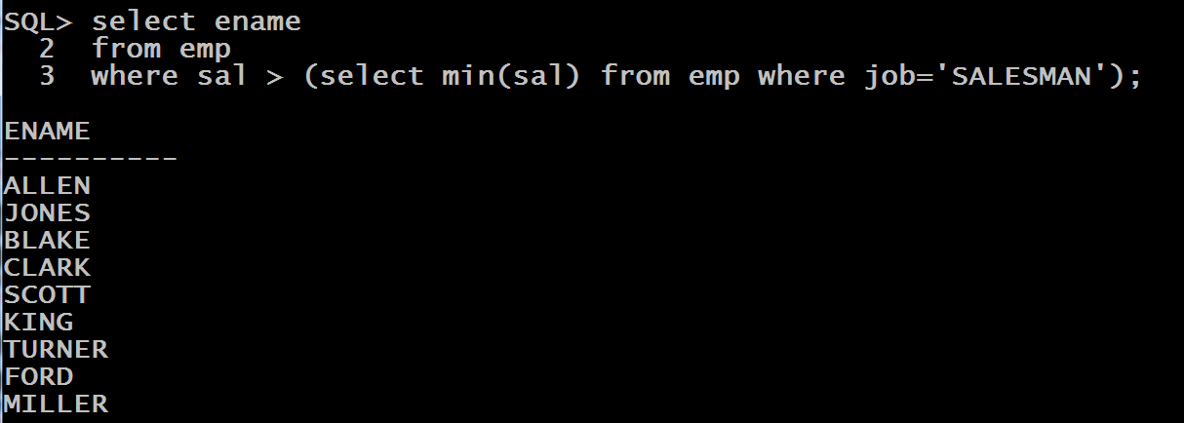
Queries
WAQ to display the names of all the employees whose salary is greater than the salary of any SALESMAN ?
Solution 1:
Solution 2:

Slide 12
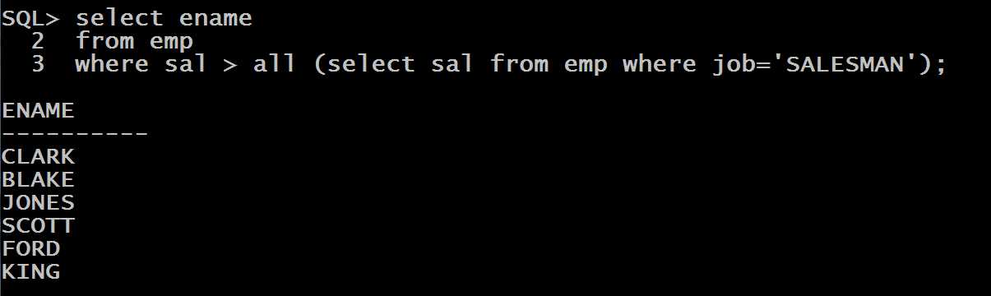
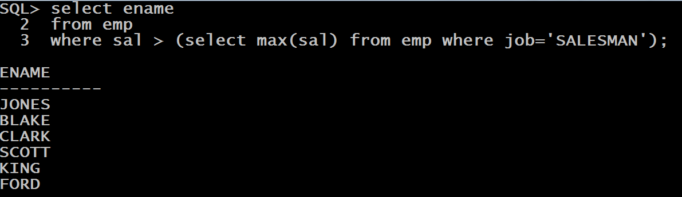
Queries
WAQ to display the names of all the employees whose salary is greater than the salary of every SALESMAN ?
Solution 1:
Solution 2:

Slide 13
The EXISTS Operator
The EXISTS operator is used for CORRELATED SUBQUERIES and it tests whether the subquery returns at least one row.
Because EXISTS tests only whether a row exists, the columns shown in the SELECT list of the subquery are irrelevant.
Typically, we use a single-character text literal, such as ‘X’, or the keyword NULL or any number like 1.

Slide 14
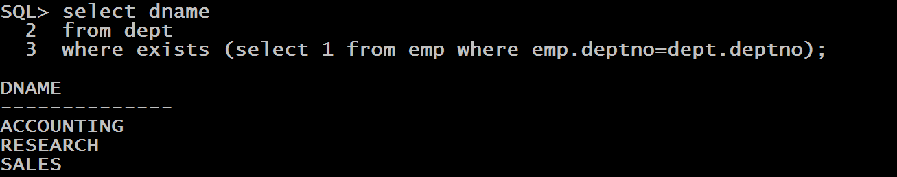
Query
WAQ to display names of those departments who have employees working in them.
For every row of the DEPT table, the OUTER QUERY evaluates the INNER QUERY.
It checks whether the current row’s DEPTNO value exists for the EMP table’s DEPTNO column.
If a row with the appropriate value is found, the condition is true, and the outer row is included in the result.

Slide 15
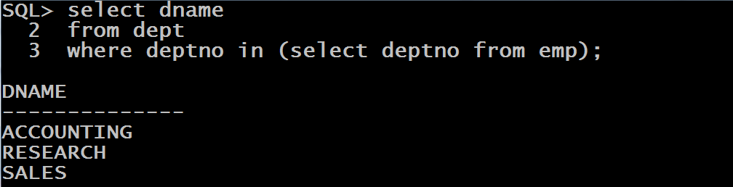
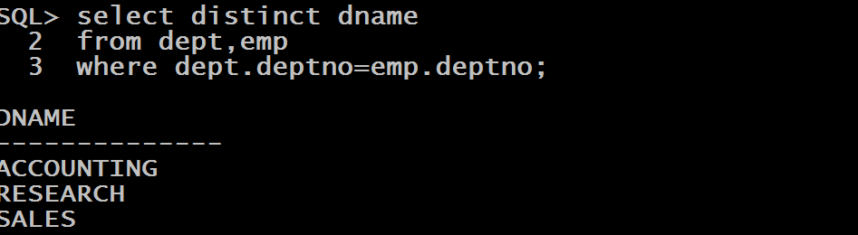
Alternate Solutions
We also can write above query using IN operator
Also the same query can be written using equi join

Slide 16
The NOT EXISTS Operator
The NOT EXISTS operator is the opposite of the EXISTS operator; it tests whether a matching row CANNOT BE FOUND.
The operator is the most frequently used with CORRELATED SUBQUERY construct.

Slide 17
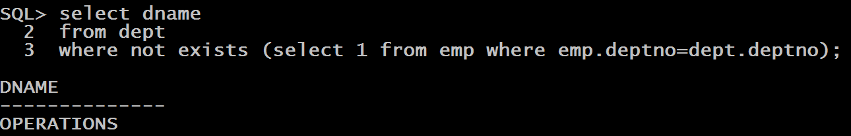
Query
WAQ to display names of those departments who do not have employees working in them.

Slide 18
Answer This
Can we rewrite the previous query using th NOT IN operator ?
Yes , we can rewrite it with the NOT IN operator.
However, the NOT IN operator does not always yield the same result if NULL values are involved.

Slide 19
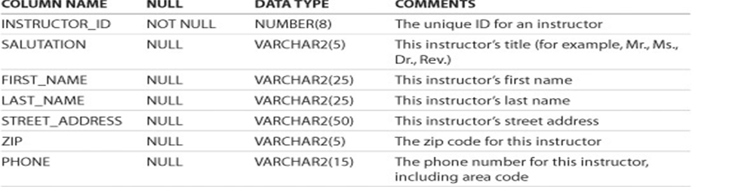
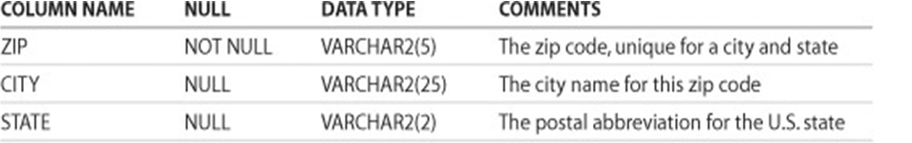
NOT EXISTS V/s NOT IN
INSTRUCTOR
ZIPCODE

Slide 20
NOT EXISTS V/s NOT IN
WAQ to display the INSTRUCTOR_ID, FIRST_NAME, LAST_NAME, and ZIP columns from the INSTRUCTOR table where there is no corresponding zip code in the ZIPCODE table.
Remember that the ZIP column in the INSTRUCTOR table allows NULL values and these INSTRUCTORS should be displayed in the output

Slide 21
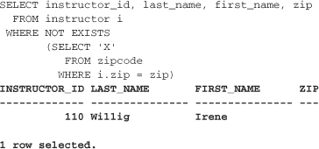
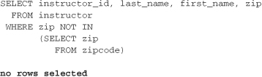
NOT EXISTS V/s NOT IN
Using NOT EXISTS
Using NOT IN

Slide 22
The Difference
As you can see, the difference between NOT EXISTS and NOT IN lies in the way NULL values are treated.
Instructor Irene Willig’s ZIP column contains a NULL value.
The NOT EXISTS operator tests for NULL values; the NOT IN operator does not.

